Slide 1
MODULE 4
LIDAR Sensing

Slide 2
Module 4 | LIDAR Sensing
In this module…
Operating principles of LIDAR sensors
Basic LIDAR sensor models
Working with LIDAR point clouds
Localization via point cloud registration
point set registration problem, one of the most important problems in computer vision（コンピュータビジョン） and pattern recognition（パターン認識）.

Slide 3
MODULE 4 LESSON 1
LIGHT DETECTION AND RANGING SENSORS
もしくはLaser Imaging Detection and Ranging（レーザー画像検出と測距「そっきょ」）の略

Slide 4


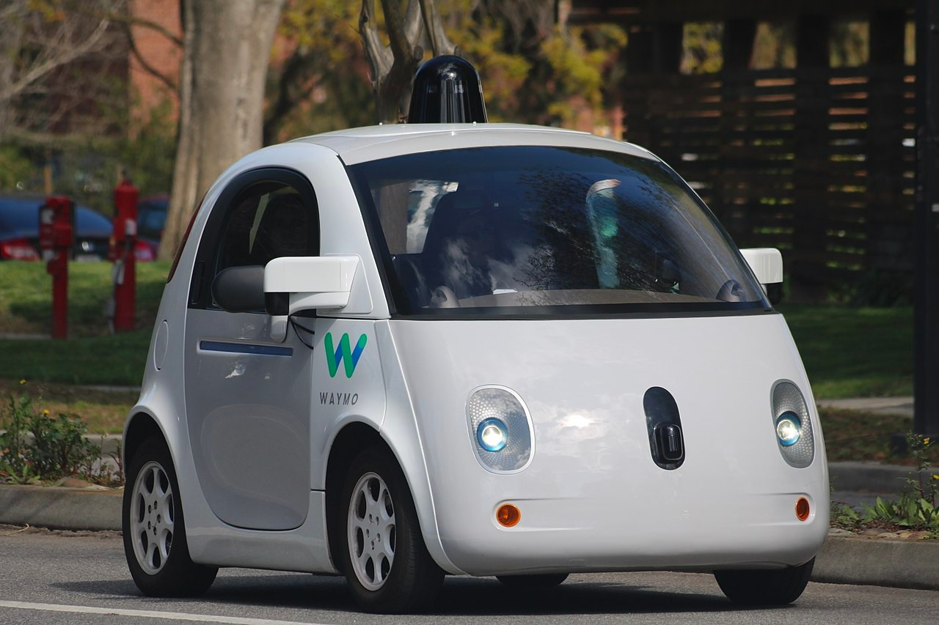
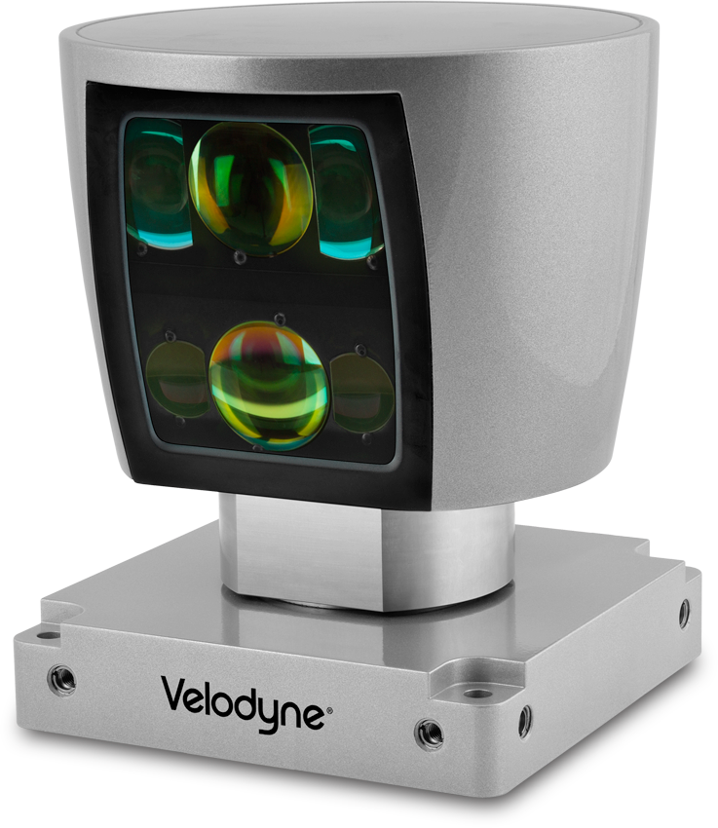
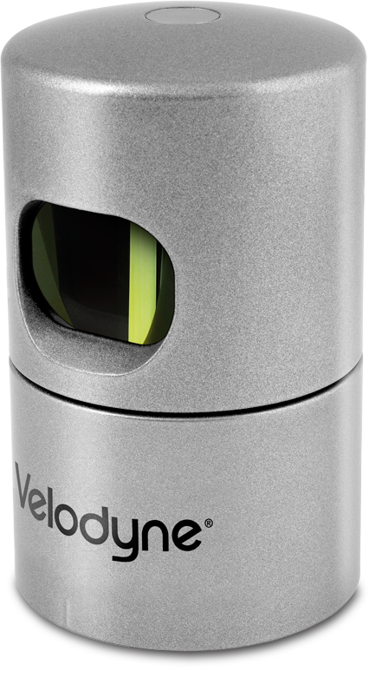
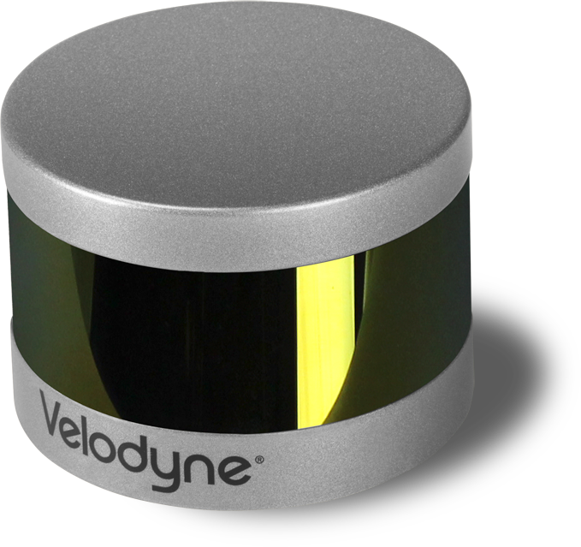


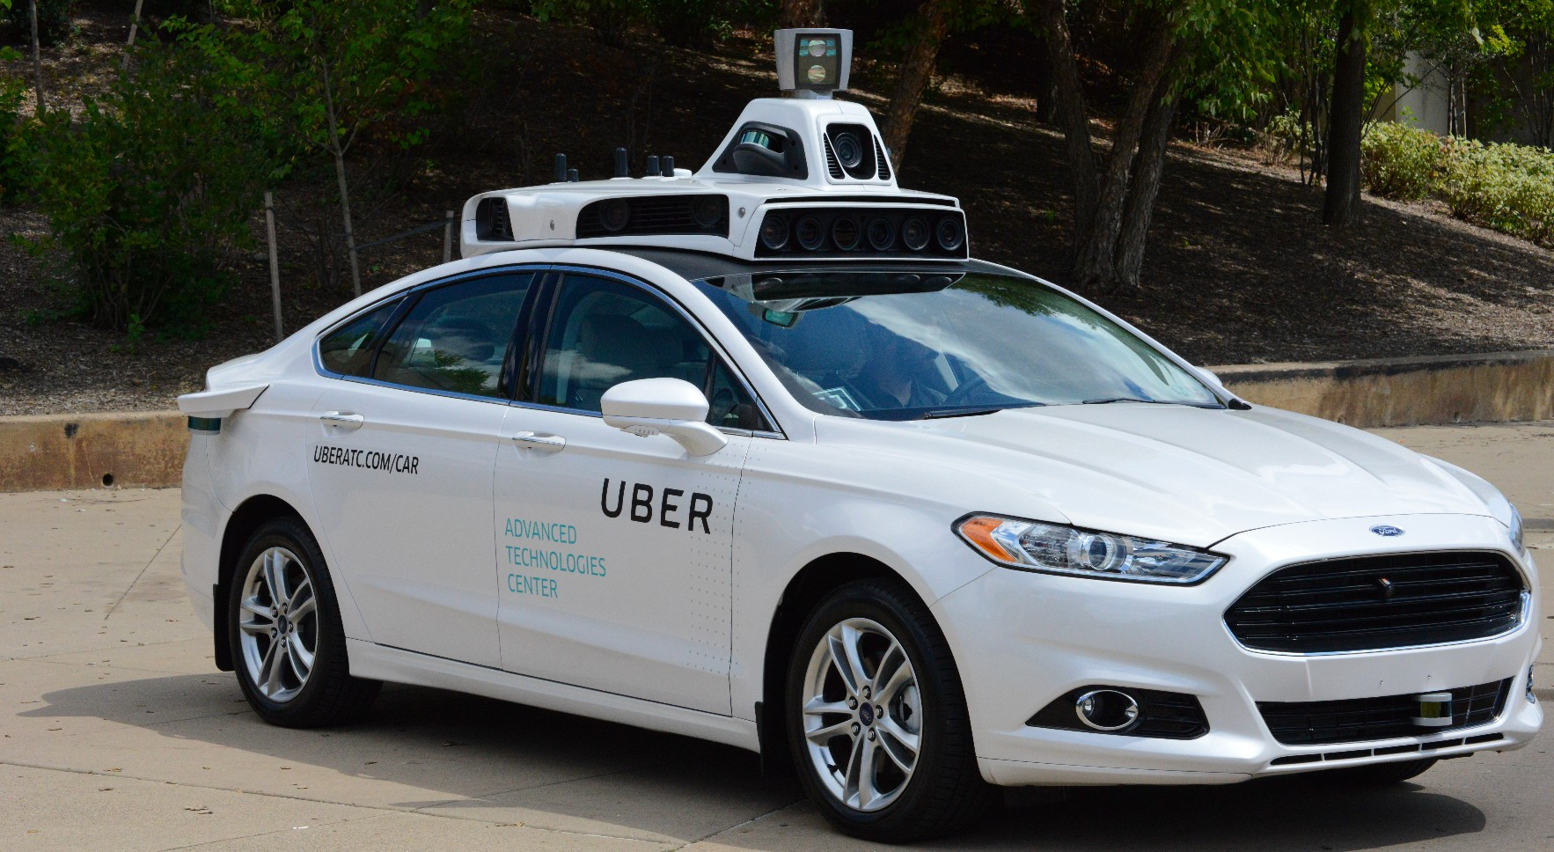
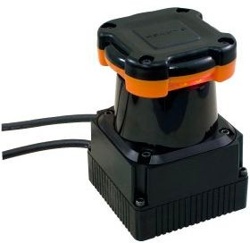
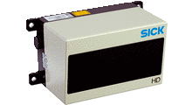
LIDAR: Light Detection and Ranging
can measure distances to a single point, a 2D slice of the world, or perform a full 3D scan.
メーカー：Velodyne in California, Hokuyo（北陽電機） in Japan, SICK in Germany
Velodyne
ベロダイン
Hokuyo
SICK

Slide 5



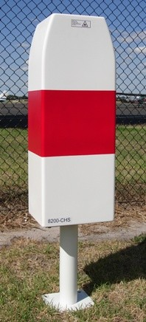

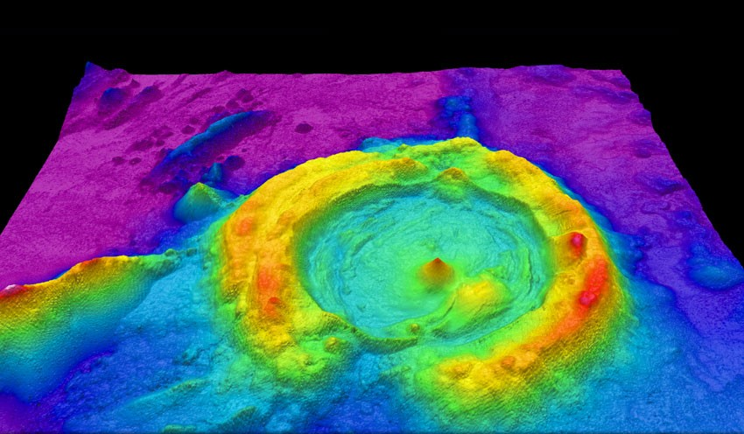
Measuring Earth, Sea and Sky
LIDAR originated in the 1960s shortly after the invention of the laser
First used by meteorologists（気象学者） to measure clouds
A ground-based ceilometer（雲高計、うんこうけい） measures the height of a cloud ceiling
not only to measure water clouds, but also to detect volcanic ash（火山灰「ばい」） and air pollution.
Now commonly used for surveying and mapping
Airborne（空中） LIDAR sensors are commonly used to survey and map the earth’s surface for agriculture, geology（地質「ちしつ」学）, military, and other uses.
An airborne LIDAR measures the geometry of the seafloor（海底「かいてい」）

Slide 6


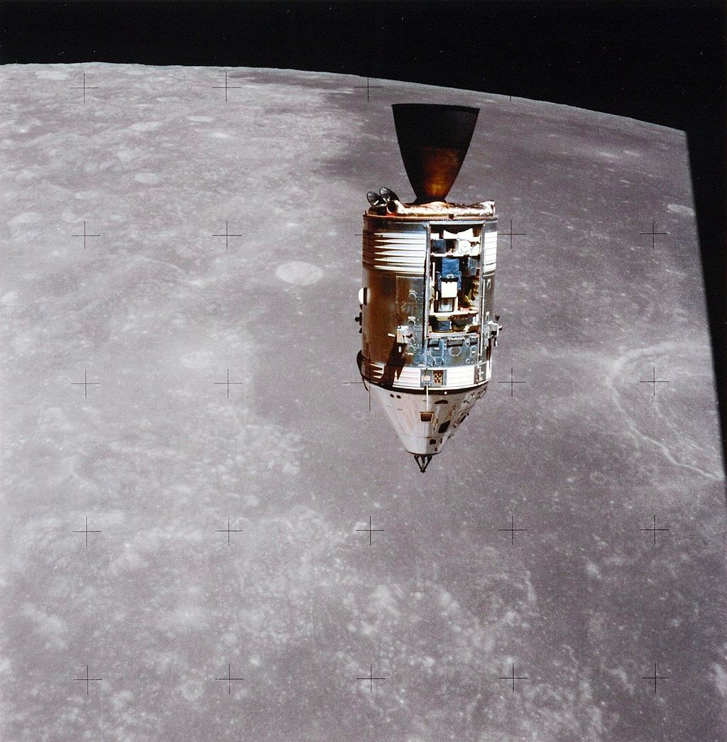
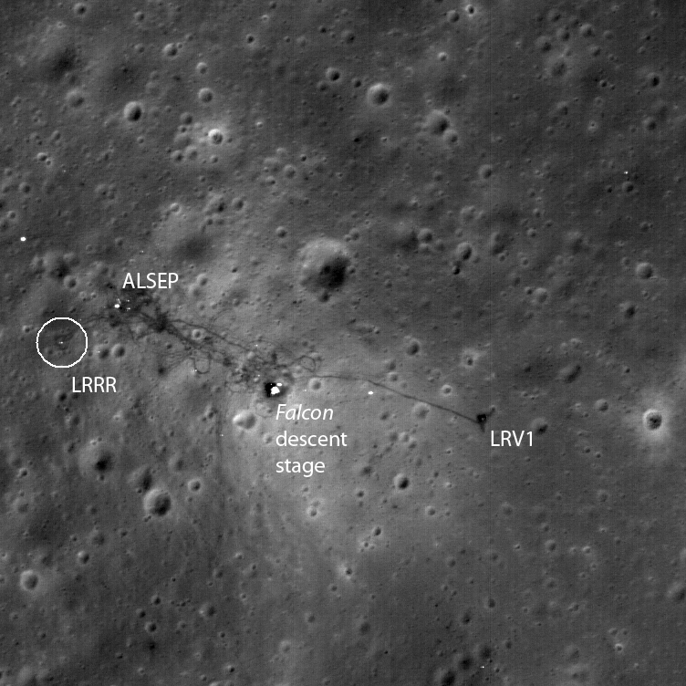

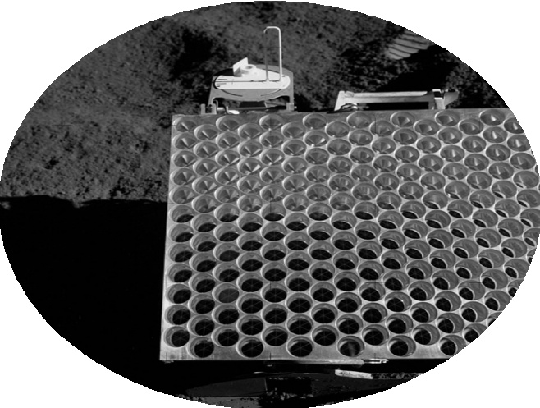
Apollo 15
Apollo 15 Command Module
Apollo 15: use a laser altimeter（高度計） to map the surface of the moon.
Laser Ranging Retroflector
Apollo 15 Landing Site

Slide 7






Measuring Distance with Time-of-Flight
1点の場合：
To build a basic LIDAR in one dimension: a laser, a photodetector（光検出器）, a very precise stopwatch（ストップウォッチ）.
The laser first emits a short pulse（パルス） of light, usually in the near infrared frequency band along some known ray direction.
At the same time, the stopwatch begins counting.
Distance
Time elapsed (round-trip)
r = ¹ c ⋅ t
2
As long as the surface of the target isn’t too polished（磨かれた） or shiny（ぴかぴか）, the laser pulse will scatter（光散乱） off the surface in all directions, and some of that reflected light will travel back along the original ray direction.
round-trip time（RTT, ラウンドトリップタイム）.
Speed of light
Since light travels much faster than cars, it’s a good approximation to think of the LIDAR and the target as being effectively stationary during the few nanoseconds（ナノ秒） that it takes for all of this to happen.
The photodetector also tells the intensity of the return pulse relative to the intensity of the pulse that was emitted（放出された）.
This intensity information is less commonly used for self-driving, but it provides some extra information about the geometry of the environment and the material the beam is reflecting off of.
intensity informationの使い⽅：create 2D images from LIDAR intensity data and then use computer vision algorithms.
See in the dark: since LIDAR is its own light source, it provides a way for self-driving cars to see in the dark.

Slide 8
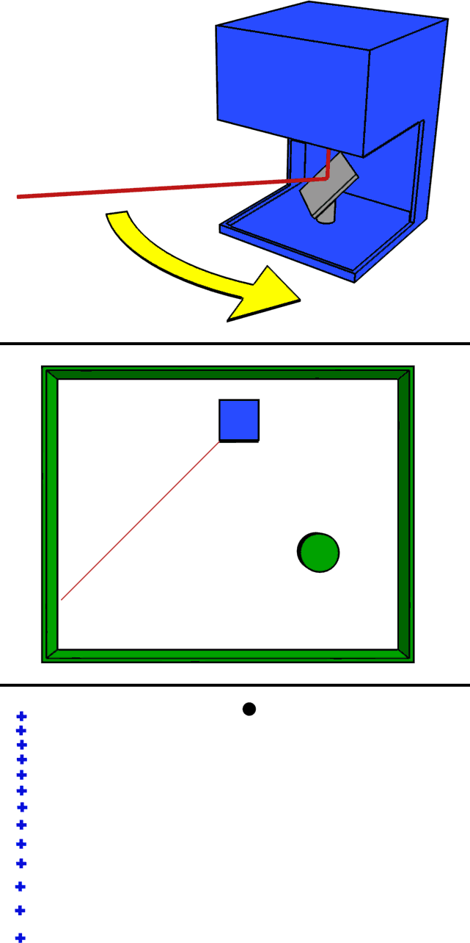
Measuring distance with time-of-flight
2D&3Dの場合：
Build a rotating mirror into the LIDAR that directs（向ける） the emitted pulses along different directions.
As the mirror rotates, measure distances at points in a 2D slice（スライス、薄切り「ぎり」） around the sensor.
If then add an up and down nodding（うなずく、頷く） motion to the mirror along with the rotation, can use the same principle to create a scan in 3D.

Slide 9
Velodyne LIDARのやり⽅：sensors create multiple 2D scan lines from a series of individual lasers spaced at fixed angular intervals, which effectively paint the world with horizontal stripes（縞、しま） of laser light. レーザーが縦に並んでいると思う。
The black hole in the middle is a blind spot where the sensor itself is located, and the concentric circles spreading outward from there are the individual scan lines produced by the rotating Velodyne sensor.
Each point in the scan is colored by the intensity of the return signal.

Slide 10

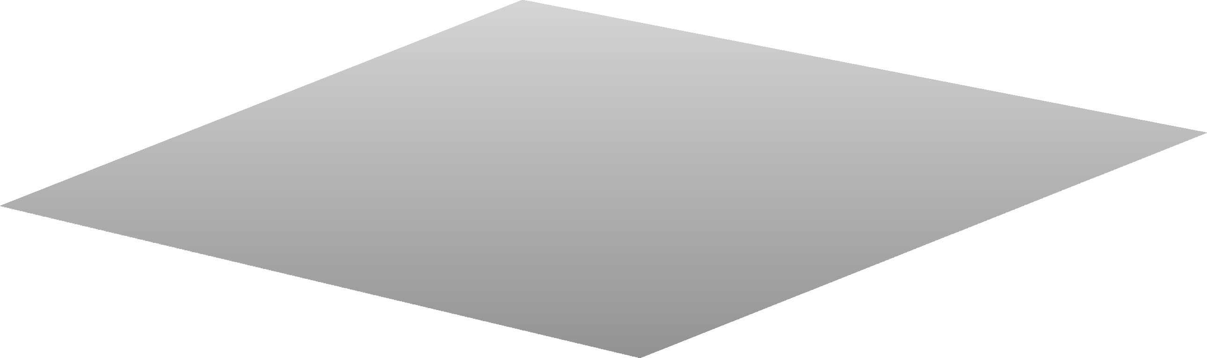



Measurement Models for 3D LIDAR Sensors
3D LIDAR sensors report range, azimuth angle and elevation angle (+ return intensity)
P (x, y, z)
ℱ
r range
s
ϵ elevation
S
α azimuth
azimuth angle, measured counterclockwise from the sensor’s x-axis.
The azimuth and elevation angles are measured using encoders that tell the orientation of the mirror.
For Velodyne LIDARs, the elevation angle is fixed for a given scan line.

Slide 11





Measurement models for 3D LIDAR sensors
P (x, y, z)
ℱ
r range
s
ϵ elevation
S
α azimuth
Inverse Sensor Model
Forwards Sensor Model
x² + y² + z²
y
x y
[_{z}]
r cos α cos ϵ r sin α cos ϵ
r
−1
tan⁻¹
= h (r, α, ϵ) =
α = h ₍x, y, z₎ =
( x )
[
]
[_{ϵ}]
r sin ϵ
sin⁻¹
z x² + y² + z² )
(
EKFの課題を紹介した時、このモデルを例にした。

Slide 12




Measurement models for 2D LIDAR sensors
ℱ
s
S
r range
P (x, y,0)
α azimuth
ϵ = 0 elevation
Inverse Sensor Model
Forwards Sensor Model
x y
[₀]
r cos α r sin α
x² + y²
r
α
[₀]
= h⁻¹ (r, α,0) =
= h ₍x, y,0₎ =
[
]
tan
−1
y
( x )
0
0

Slide 13
Sources of Measurement Noise
Uncertainty in determining the exact time of arrival of the reflected signal
Uncertainty in measuring the exact orientation of the mirror
Interaction with the target (surface absorption（吸収、例えばcompletely black）, specular reflection（鏡面反射）, etc.)
Variation of propagation speed (e.g., through materials)
原因：the stopwatch has a limited resolution.
同じresolutionの原因。
In both of these cases, the LIDAR will typically report a maximum range error, which could mean there is empty space along the beam direction, or that the pulse encountered a highly abortive or highly reflective surface.
x² + y² + z²
y
r
α
Forwards Sensor Model (with Noise)
= h ₍x, y, z, v₎ =
tan⁻¹
( x )
+ v
[_{ϵ}]
sin⁻¹
z x² + y² + z² )
(
v ∼ 𝒩 ₍0, R₎
an empirically determined or manually tuned covariance.

Slide 14
Motion Distortion
Typical scan rate for a 3D LIDAR is 5-20 Hz
For a moving vehicle, each point in a scan is taken from a slightly different place（鏡が回転しているから）
Need to account for this if the vehicle is moving quickly, otherwise motion distortion becomes a problem
Although the car is unlikely to be moving at an appreciable fraction of the speed of light, it is often going to be moving at an appreciable fraction of the rotation speed of the sensor itself. （自車の移動はレーザーの伝播と比べると、無視できるが、鏡の回転と比べたら、無視できない）
Correcting this motion distortion（歪み） usually requires an accurate motion model for the vehicle provided by GPS and INS for example.

Slide 15
MODULE 4 LESSON 2
LIDAR SENSOR MODELS AND POINT CLOUDS

Slide 16

LIDAR Point Clouds
For some LIDAR setups, it’s not uncommon for these point clouds to contain upwards of a million points or more.
P (x, y, z)
ℱ
r range
s
ϵ elevation
S
α azimuth
x
r cos α cos ϵ
y
−1
r sin α cos ϵ r sin ϵ
= h (r, α, ϵ) =
[ ]
[
]
z

Slide 17







LIDAR Point Clouds
ℱ
s
S

Slide 18


LIDAR Point Clouds | Data Structures
_{x}(1) _{x}(2) _{⋯ x}(n)
_{x}(1)
s s
s
s
P =
(1) _{p}(2)
(n) _{y}(1) _{y}(2) _{⋯ y}(n)
_{p}(1) ₌
_{y}(1)
s
[
p
⋯ p
]
=
s
s
s
s
s
s
s
s
_{z}(1)
_{z}(2)
⋯
_{z}(n)
_{z}(1)
s
s
s
s
ℱ
s
S
_{x}(n)
s
_{p}(n) ₌
_{y}(n)
s
s
_{z}(n)
s

Slide 19












Operations on Point Clouds
考え⽅：Objects in the world mostly stay put（もとの所にとどまる） while the reference frame attached to the vehicle moves and observes the world from different perspectives.
1. Translation
2. Rotation
3. Scaling

Slide 20

Operations on Point Clouds | Translation
P
From vector addition
_{r} ps′ _{= r} ps _{− r} s′s
_{r} ps
_{r} ps′
ℱ
s
ℱ
Point coordinates in the translated frame
_{r} s′s
s′
S
_{p}( j) _{= p}( j) _{− r}s′s
s′
s s
each point
S′
P_{s′} = P_{s} − R^{s′s}
whole cloud
Lidarが移動した
s
R
s′s
=
[
_{r}s′s s′s s′s _{s} r ⋯ r
s
s
s
Depending on the language or linear algebra library, probably not need to build this R matrix explicitly.
In Python, the NumPy library is smart enough to repeat the frame-to-frame translation implicitly using broadcasting semantics.

Slide 21

Operations on Point Clouds | Rotation
P
The rotation matrix takes
coordinates from frame s to frame s’
_{r} ps
^{r}s′ ^{= C}s′s ^{r}s
What does change in this case is actually the set of basis vectors（基底、きてい） we use to express the coordinates of the vector S to P.
ℱ
s′
ℱ
s
Point coordinates in the rotated frame
_{p}( j) _{= Cs′s p}( j)
s′
s
each point
S
^{P}s′ ^{= C}s′s ^{P}s
whole cloud

Slide 22
Operations on Point Clouds | Scaling
The scaling matrix is composed of scaling factors for each basis vector of frame s
P
ℱ
s′
_{r} ps
s 0 0
0 s_{y} 0
0 0 s_{z}
^{S}s′s
x
Often, but not always, these scaling factors are the same.
r_{s′} =
r_{s}
ℱ
s
S
Point coordinates in the scaled frame
_{p}( j) _{= Ss′s p}( j)
s′
s
each point
^{P}s′ ^{= S}s′s ^{P}s
whole cloud

Slide 23

Operations on Point Clouds | Putting Them All Together
P
使⽤例：estimating the translation and rotation that best aligns to point clouds so that we can estimate the motion of the self-driving car.
Point coordinates in the transformed frame
_{r} ps
_{r} ps′
p
( j)
= S C p
( j)
− r
s′s
each point
s′
s′s s′s
(
s
s
)
ℱ
ℱ
s′
s
3. Scale
2. Rotate
1. Translate
_{r} s′s
S
^{P}s′ ^{= S}s′s^{C}s′s
(
P − R
s′s
)
whole cloud
s
s
S′

Slide 24


Finding the Road with 3D Plane Fitting
Where is the road now? Where is it going to be?

Slide 25








Finding the Road with 3D Plane Fitting
Equation of a plane in 3D:
We have measurements of (x, y, z) and we want to determine the parameters (a, b, c) — use least- squares!
z = a + bx + cy
Measurement error:
e_{j} = z_{j}̂ − z_{j}
= ₍â+ b̂x_{j} + cŷ _{j)} − z_{j}
j = 1...n

Slide 26
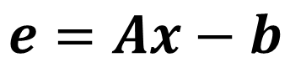
Finding the Road with 3D Plane Fitting
We can stack all of the measurement errors into matrix form
e₁ e₂
⋮
e_{n}
e
1 x₁ y₁
1 x₂ y₂
⋮ ⋮ ⋮
1 x_{n} y_{n}
A
z₁ z₂
⋮
z_{n}
b
a
=
b
−
[ ]
$$e=Ax−b$$
c
⏟
x
And minimize the squared-error criterion to get the least-squares solution for the parameters
x̂ = argmin _{x} ℒ_{LS}(x) ℒ_{LS}(x) = e^{T}e
= ₍Ax − b₎^{T} ₍Ax − b₎
= x^{T} A^{T} Ax − x^{T} A^{T} b − b^{T} Ax + b^{T} b

Slide 27
Finding the Road with 3D Plane Fitting
x̂ = argmin _{x} ℒ_{LS}(x)
ℒ_{LS}(x) = x^{T} A^{T} Ax − x^{T} A^{T} b − b^{T} Ax + b^{T} b
Taking the partial derivative with respect to x and setting to zero for an optimum gives us the familiar normal equations
∂ℒ_{LS}(x)
∂x
= 2A^{T} Ax̂ − 2A^{T} b = 0
A^{T} Ax̂ = A^{T} b
x=x̂
We can solve for x using an efficient numerical solver or by using the pseudo-inverse(疑似逆行列)
x̂ = ₍A^{T} A₎⁻¹ A^{T} b
like Python NumPy’s solve function
注意点：まだnot account for sensor noise in x, y, z measurements.
You could even think about including the road parameters in the Kalman filter to estimate them on the fly as the sensor data comes in.
the best solution will depend on how much you trust your LIDAR data and how much thought you want to give to uncertainty in the road surface.
この方法は外れ値（路面以外の点）に影響されるので、最近受けたLidar研修にはRANSACを使っていた。（road point cloudやobject point cloudを分離する、路面が平面であることは前提だが）
left inverse

Slide 28

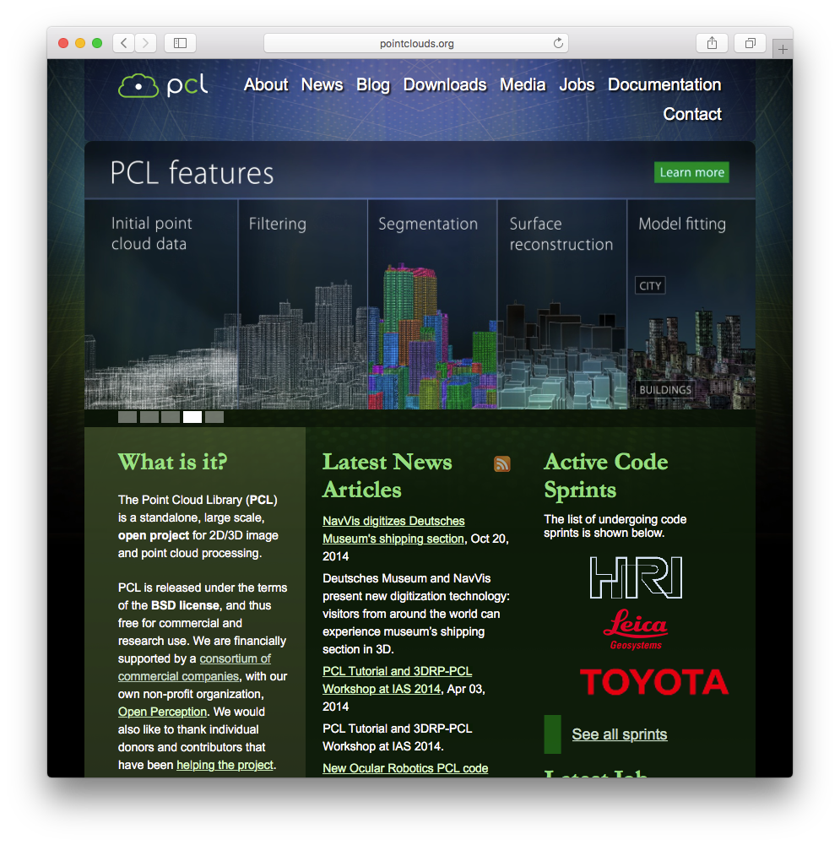
The Point Cloud Library (PCL)
http://pointclouds.org
Open-source Point Cloud Library (PCL) has many useful functions for doing basic and advanced operations on point clouds in C++
Widely used in industry
Unofficial Python bindings exist
One of the most useful algorithms in PCL is called the iterative（反復、はんぷく） closest point algorithm, or ICP, which is a common method for estimating the motion of a self-driving car using two LIDAR point clouds. もうすぐ紹介する。
https://pointclouds.org/documentation/classpcl_1_1_iterative_closest_point.html

Slide 29
Summary | Point Clouds
The Cartesian coordinates of all the measurements from a LIDAR scan are stored in a point cloud
Point clouds can be translated, rotated, or scaled
We can use point clouds for useful self-driving tasks, like fitting a 3D plane to find the road surface
The Point Cloud Library (PCL) implements many useful tools for working with points clouds in C++
RANSACもできる

Slide 30
MODULE 4 LESSON 3
POSE ESTIMATION FROM LIDAR DATA
1

Slide 31
State Estimation via Point Set Registration
ℱ
s
S

Slide 32

State Estimation via Point Set Registration
ℱ
s
S

Slide 33
State Estimation via Point Set Registration
ℱ
s′
S′

Slide 34





State Estimation via Point Set Registration
ℱ
s′
S′

Slide 35
State Estimation via Point Set Registration
What motion of the car best aligns（揃える） the two point clouds?
point set registration problemの定義：given 2 point clouds in two different coordinate frames, and the knowledge that they correspond to or contain the same object in the world, how shall we align them to determine how the sensor must have moved between the two scans?
定義２：figure out the optimal translation and the optimal rotation between the two sensor reference frames that minimizes the distance between the 2 point clouds
ℱ
s
S
P_{s}
Want
{
C , r
s′s
}
s′s s
ℱ
s′
^{P}s′
S′
同じオブジェクトが含まれることは、ICPだけの条件ではない。マッチングが成立する前提だと思う。例えば画像処理にKeypoint matchingが成功する前提は、画像に同じオブジェクトが含まれることだと思う。

Slide 36
State Estimation via Point Set Registration
What motion of the car best aligns the two point clouds?
ℱ
s
S
P_{s}
Want
{
C , r
s′s
}
s′s s
ℱ
s′
^{P}s′
S′

Slide 37
State Estimation via Point Set Registration
What motion of the car best aligns the two point clouds?
ℱ
ℱ
s
s′
^{P}s ^{P}s′
S
S′
̂
s′s
C
̂
, r
{
s′s s }

Slide 38
State Estimation via Point Set Registration
What motion of the car best aligns the two point clouds?
ℱ
ℱ
s
s′
^{P}s ^{P}s′
S
S′
̂
s′s
C
̂
, r
{
s′s s }
Problem: We don’t know which points correspond（対応） to each other （対応する点ペアを決めないと、PとP’行列さえ作れないからだと思う）

Slide 39
The Iterative Closest Point (ICP) Algorithm
Intuition: When the optimal motion is found, corresponding points will be closer to each other than to other points
the pairs of points that truly correspond to each other will be the ones that are closest to each other in a Euclidean sense.
^{P}s ^{P}s′
Heuristic（ヒューリスティック、発見的）: For each point, the best candidate（候補者） for a corresponding point is the point that is closest to it right now
課題：because the vehicle is moving, it’s almost never the case that a laser beam will hit exactly the same surface point twice.
ヒューリスティック：必ず正しい答えを導けるわけではないが、ある程度のレベルで正解に近い解を得ることができる

Slide 40












The Iterative Closest Point (ICP) Algorithm
Lidar点群だからscaleはいらないと思う。
Procedure:
ˇ
s′s
s′s s }
C
ˇ
1. Get an initial guess for the transformation
{
, r
Motion modelから得る
P
s′
there’s no guarantee that the closest point heuristic will actually converge to the best solution.
It’s very easy to get stuck in a local minimum in these kinds of iterative optimization schemes.
One of the most common sources for robotics applications like self-driving is a motion model, which could be supplied by an IMU or by wheel odometry, or even a constant velocity / zero velocity model.
How complex the motion model needs to be to give a good initial guess really depends on how smoothly the car is moving.
If the car is moving slowly relative to the scanning rate of the LIDAR sensor, one may even use the last known pose as the initial guess.
P_{s}

Slide 41
The Iterative Closest Point (ICP) Algorithm
Procedure:
ˇ
s′s
s′s s }
C
ˇ
1. Get an initial guess for the transformation
{
, r
2. Associate each point in P_{s’} with the nearest point in P_{s}
対応する点のペアを決める
Use the initial guess to transform the coordinates of the points in one cloud into the reference frame of the other, and then match each point the second cloud to the closest point in the first cloud.
右の図には点列の順番がありそうと見えているが、順番がないと思う。
マッチングは片方向（2番目点群->1番目点群）のみだと思う。（なので、両Point Cloudのサイズが一致しなくてもいいと思う）

Slide 42











The Iterative Closest Point (ICP) Algorithm
Procedure:
ˇ
s′s
s′s s }
C
ˇ
1. Get an initial guess for the transformation
{
, r
2. Associate each point in P_{s’} with the nearest point in P_{s}
3. Solve for the optimal transformation
̂
s′s
C
̂
, r
{
s′s s }
Find the transformation that minimizes the sum of squared distances between the corresponding points.

Slide 43





The Iterative Closest Point (ICP) Algorithm
Procedure:
ˇ
s′s
s′ss s }
C
ˇ
1. Get an initial guess for the transformation
{{
, r
2. Associate each point in P_{s’} with the nearest point in P_{s}
̂
s′s
3. Solve for the optimal transformation C
̂
, r
{
s′s s }
4. Repeat until convergence

Slide 44
The Iterative Closest Point (ICP) Algorithm
Procedure:
ˇ
s′s
s′s s }
C
ˇ
1. Get an initial guess for the transformation
{
, r
2. Associate each point in P_{s’} with the nearest point in P_{s}
̂
s′s
̂
3. Solve for the optimal transformation C
, r
{
s′s s }
4. Repeat until convergence

Slide 45

The Iterative Closest Point (ICP) Algorithm
Procedure:
ˇ
s′s
s′s s }
C
ˇ
1. Get an initial guess for the transformation
{
, r
2. Associate each point in P_{s’} with the nearest point in P_{s}
̂
s′s
3. Solve for the optimal transformation C
̂
, r
{
s′s s }
4. Repeat until convergence

Slide 46
The Iterative Closest Point (ICP) Algorithm
Procedure:
ˇ
s′s
s′s s }
C
ˇ
1. Get an initial guess for the transformation
{
, r
2. Associate each point in P_{s’} with the nearest point in P_{s}
̂
s′s
C
̂
3. Solve for the optimal transformation
, r
{
s′s s }
4. Repeat until convergence

Slide 47
ICP | Solving for the Optimal Transformation
̂
s′s
How do we solve for the optimal
C
, r
̂ at each step?
{
s′s s }
̂
s′s
s′s
C
̂
Use least-squares!
, r = argmin _{{C}
ℒ C , r
{
s′s s }
s′s
LS
(
s′s s
)
s′s^{, r}s }
n
_{− p}( j)
2
ℒ C , r
s′s
= C_{s′s (}p^{( j)} − r^{s′s}
LS
(
s′s s
)
∑
s
s )
s′
j=1
2
Careful: Rotations need special treatment because they don’t behave like vectors!
理由：If you add two rotation matrices together, the result is not necessarily a valid rotation matrix.
3D rotations belong to something called the special orthogonal group（特殊直交群、回転群） or SO(3). 分かっていない。

Slide 48
ICP | Solving for the Optimal Transformation
1. Compute the centroids（重心） of each point cloud
n
_{p}( j)
n
_{p}( j)
μ = ¹
_{n} ∑
μ = ¹
_{n} ∑
s
s
s′
s′
j=1
j=1
2. Compute a matrix capturing the spread（広がり） of the two point clouds
₌ 1
n
_{p}( j) _{− μ}
_{p}( j) _{− μ}
T
Cross-covariance（相互「そうご」共分散）みたいと思う。
W
s′s
∑
( ^{s}) ( s′
s′)
n
s
j=1

Slide 49
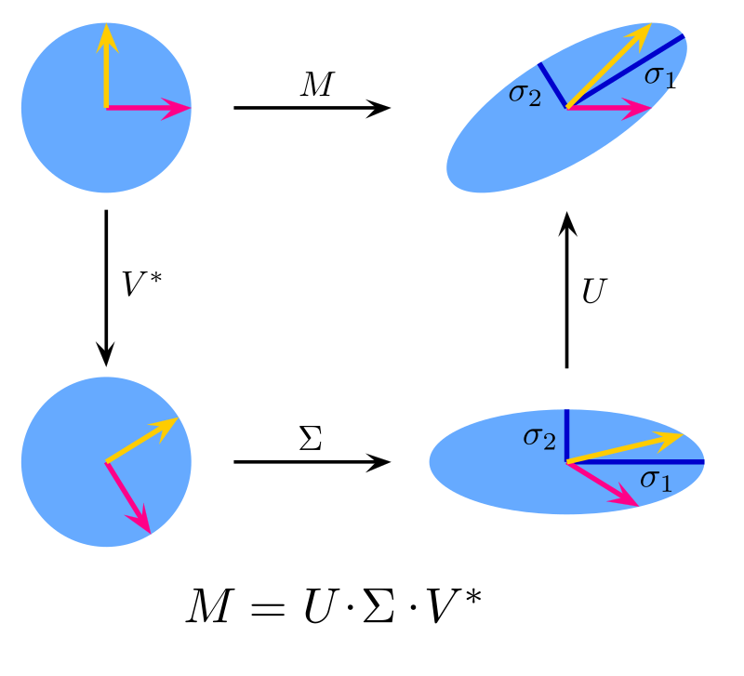
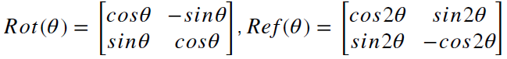
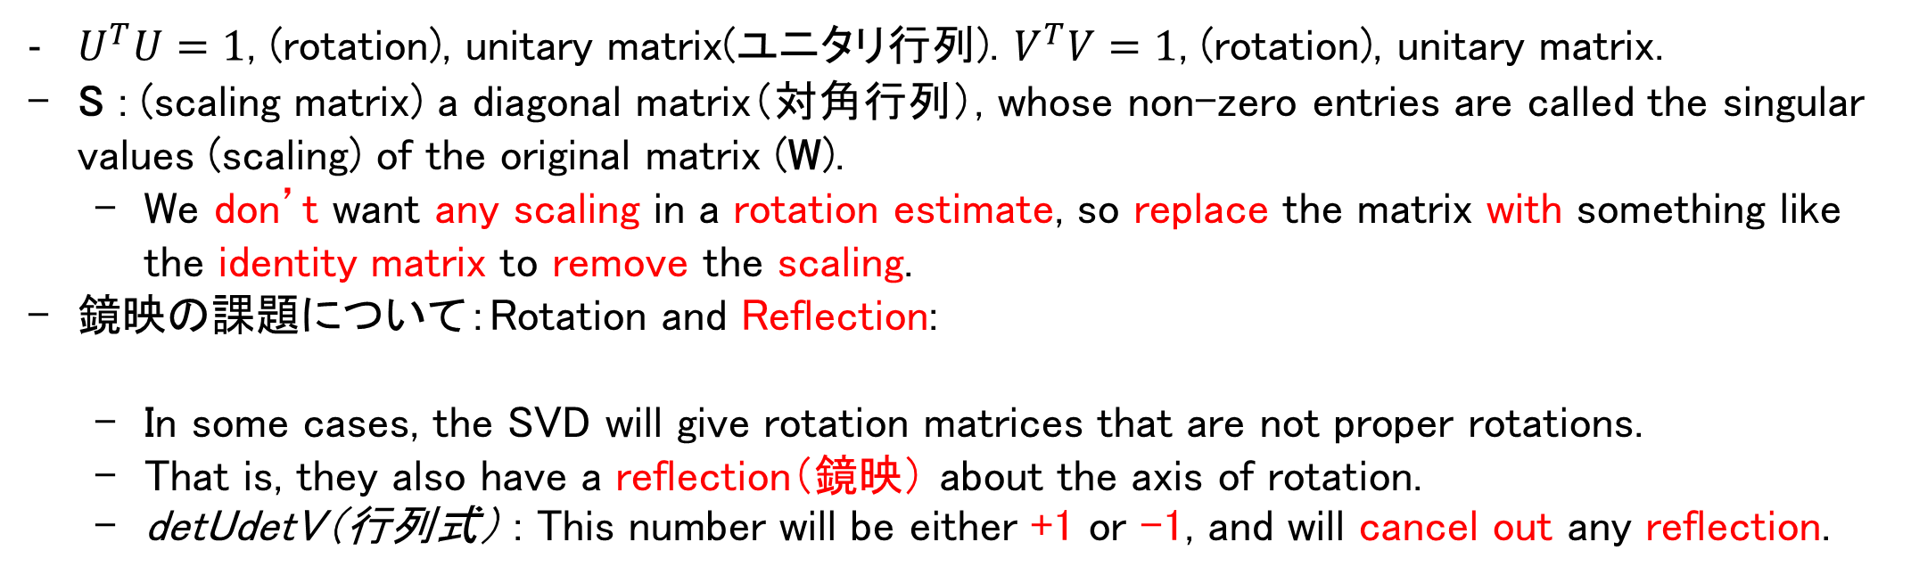
ICP | Solving for the Optimal Transformation
3. Use the singular value decomposition（特異値分解） of the matrix to get the optimal rotation
singular values (scaling)
https://en.wikipedia.org/wiki/Rotation_matrix
a square matrix R is a rotation matrix if and only if R^{T} = R⁻¹ and det R = 1.
なので、det Rが1だったらRは回転。det Rが-1だったらRは鏡映。
1 0
0
USV^{T} = W_{s′s}
V^{T} V = 1
(rotation)
Ĉ_{s′s} = U 0 1
0
_{V}T
0 0 det U det V
U^{T} U = 1
(rotation)
This term ensures that we get a proper rotation without any reflection（鏡映）
$U^{T}U=1$, (rotation), unitary matrix(ユニタリ行列). $V^{T}V=1$, (rotation), unitary matrix.
S : (scaling matrix) a diagonal matrix（対角行列）, whose non-zero entries are called the singular values (scaling) of the original matrix (W).
We don’t want any scaling in a rotation estimate, so replace the matrix with something like the identity matrix to remove the scaling.
鏡映の課題について：Rotation and Reflection:
In some cases, the SVD will give rotation matrices that are not proper rotations.
That is, they also have a reflection（鏡映） about the axis of rotation.
detUdetV（行列式） : This number will be either +1 or -1, and will cancel out any reflection.
det U, det Vが1の場合のみ、回転として理解できると思う。
https://en.wikipedia.org/wiki/Singular_value_decomposition

Slide 50
ICP | Solving for the Optimal Transformation
3. Use the singular value decomposition of the matrix to get the optimal rotation
singular values (scaling)
1 0
0
USV^{T} = W_{s′s}
V^{T} V = 1
(rotation)
Ĉ_{s′s} = U 0 1
0
_{V}T
0 0 det U det V
U^{T} U = 1
(rotation)
This term ensures that we get a proper rotation without any reflection
4. Use the optimal rotation to get the optimal translation by aligning the centroids
r^{s}̂ ^{′s} = μ − C^{̂T} μ
s s
s′s
s′

Slide 51
ICP | Estimating Uncertainty
How confident should we be in the output of the ICP algorithm?
We can obtain an estimate of the covariance matrix of the ICP solution using this formula:
http://www.mva-org.jp/Proceedings/2015USB/papers/14-27.pdf
この式は、Covariance of a Minimization Algorithm.
Zはinput/measurements; xはoutput of an algorithm/function A that operates on/minimizes an object function J.
Our preliminary results show that ICP’s covariance is lower at a global minimum than at a local minima.
−1 _{∂2ℒ}
−1
∂²ℒ
∂²ℒ ^{T} ∂²ℒ
cov(x̂) ≃
( ∂x² )
∂z∂x ^{cov(z)} ∂z∂x
( ∂x² )
x=x̂
covariance of estimated motion parameters
covariance of all measurements (both point clouds)
This expression tells how the covariance of the estimated motion parameters is related to the covariance of the measurements in the two point clouds using certain second-order derivatives（2階微分） of the least squares cost function.
While its expression is accurate and fast to compute, it’s a little tricky to derive these second-order derivatives when there’s a constraint quantity like a rotation matrix in the mix. cost functionにrotation matrixが⼊っているから、second-order derivativeの計算は不便。
So generally hand tune the ICP covariance matrix to give us acceptable results. (どうやってhand tuneは分かっていない)
Hand (adverb, 副詞): with hands rather than by machine

Slide 52
ICP | Variants
Point-to-point ICP minimizes the Euclidean distance
between each point in P_{s’} and the nearest point in P_{s}
これは先ほど紹介したやり方だと思う
Point-to-point
Point-to-plane ICP minimizes the perpendicular distance between each point in P_{s’} and the nearest
plane in P_{s}
This tends to work well in structured environments like cities or indoors
構造化された環境…
fit a number of planes to the first point cloud.
These planes could represent things like walls or road surfaces.
The challenging part is actually figuring out where all the planes are.
Point-to-plane

Slide 53


Outliers | Objects in Motion
シーン：
Both vehicles are traveling at the same speed.
What motion of the car best aligns the two point clouds?
The answer is that we haven’t moved at all.
Of course, we did move, just not relative to the vehicle directly ahead of us.
動的オブジェクトはICPアルゴリズムの課題だけではなく、単眼SLAM（例えばORB_SLAM2）にも大課題だと思う。
ℱ
s
S

Slide 54

Outliers | Objects in Motion
ℱ
s
S

Slide 55




Outliers | Objects in Motion
ℱ
s′
S′

Slide 56




Outliers | Objects in Motion
ℱ
s′
S′

Slide 57
Outliers | Objects in Motion
What motion of the car best aligns the two point clouds?
ℱ
s
S
P_{s}
{
C , r
s′s
}
s′s s
ℱ
s′
S′
^{P}s′

Slide 58
Outliers | Objects in Motion
Occupancy Grid Mapに動的オブジェクトが消されるから、動的オブジェクトの点群を消すのができると思う
What motion of the car best aligns the two point clouds?
Be careful to exclude or mitigate the effects of outlying points that violate assumptions of a stationary world.
one way is fusing ICP motion estimates with GPS and INS estimates.
another way is identifying and ignoring moving objects, which could be done with computer vision techniques
another way is to choose a different loss function that is less sensitive to large errors induced by outliers than the standard squared error loss.
Loss functions which have this property are called robust（ロバスト） loss functions, or robust cost functions.
Generalizing the least squares loss function so that the contribution of each error is not simply the square of its magnitude, but rather some other function ρ（ロー）.
ℱ ℱ
s s′
S S′
P_{s} ^{P}s′
ICP alone is not always enough!
Naively using ICP in the presence of moving objects will tend to pull motion estimates away from the true motion.

Slide 59
Outliers | Robust Loss Functions
Error term
Least-squares
n
_{e}( j) _{= C}
_{p}( j) _{− r}s′s
_{− p}( j)
s′s ( s s )
( j) T ( j)
s′
ℒ = ∑ e e
j=1

Slide 60
Outliers | Robust Loss Functions
Error term
Robust loss
n
_{e}( j) _{= C}
_{p}( j) _{− r}s′s
_{− p}( j)
s′s ( s s )
( j)
s′
ℒ = ∑ ρ ₍e ₎
j=1

Slide 61
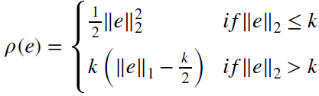
Outliers | Robust Loss Functions
Error term
Robust loss
n
_{e}( j) _{= C}
_{p}( j) _{− r}s′s
_{− p}( j)
s′s ( s s )
( j)
s′
ℒ = ∑ ρ ₍e ₎
j=1
Squared error (L₂)
Absolute error (L₁)
Cauchy（コーシー） loss
Huber loss
50
50
50
50
40
40
40
40
30
30
30
30
20
20
20
20
10
10
10
10
0
—20
0
20
0
—20
0
—20
0
—20
0
20
0
20
0
20
_{k}2
2
1
2
1
2
1
_{k}2
ρ(e) =
∥e∥² =
e^{T} e
ρ(e) = ∥e∥ = | e |
ρ(e) =
log 1 +
∥e∥²
2₎
2
1
∑
i
(
i
Key difference: the slope of the loss function does not continue to increase as the errors become larger, it remains constant or it tapers off（衰える）.
Robust loss functions make the ICP problems slightly more difficult because we can no longer derive a nice closed form（閉形式） solution for the point cloud alignment step, and this means we need to add another iterative optimization step inside the main loop. gradient descent（最急降下法）のような方法で最適化を解決すると思う。
However, the benefits cannot weigh the added complexity.

Slide 62
Summary | Pose Estimation from LIDAR Data
ICP is a way to determine the motion of a self-driving car by aligning point clouds from LIDAR or other sensors
ICP iteratively minimizes the distance between points in each point cloud
ICP is sensitive to outliers caused by moving objects, which can be partly mitigated using robust loss functions

Slide 63
Summary | LIDAR Sensing
LIDAR measures distances using laser light and the time-of-flight
equation
LIDAR scans are stored as points clouds that can be manipulated using common spatial operations (e.g., translation, rotation, scaling)
The Iterative Closest Point (ICP) algorithm is one way of using LIDAR to localize a self-driving car
論⽂： LiDAR and Inertial Fusion for Pose Estimation by Non-linear Optimization:
https://arxiv.org/pdf/1710.07104.pdf
Most compelling（説得力のある） ways to do state estimation, really are some guise（変装） of an optimization.
You need to be thinking about what you’re unsure about as well, and that’s important when you’re going to come up for some planning decisions. つまり過信しないと思う。
Wouldn’t necessarily recommend using raw least squares because the stuff, that’s an outlier.
Least squares spends all of its time worrying about rather than the stuff that makes sense.

